Slide 1

Predicting the Uninsured Rate: A Comprehensive Analysis
Introduction to the topic of predicting uninsured rates

Slide 2
Roles of Sri Chandra | Roles of Sri Sai Durga | Roles of Sireesha
Dataset Exploration | Dataset Exploration | Dataset Exploration
Modeling | Data Cleaning | Data Cleaning
Evaluation | Evaluation | Evaluation
Documentation | Documentation | Documentation
Presentation | Presentation | Presentation

Slide 3

Content
Content
Introduction
Problem Statement
Importance of Predicting the Uninsured Rate
Dataset and Features
Objectives
Methodology
Conclusion
Introduction
Problem Statement
Importance of Predicting the Uninsured Rate
Dataset and Features
Objectives
Methodology
Conclusion

Slide 4
Introduction
Today, we will explore the critical task of predicting the uninsured rate, a key indicator of healthcare accessibility and affordability.
By analyzing a comprehensive set of variables, including year, FIPS codes, county and state information, demographic factors, and uninsured population data, we aim to develop a robust predictive model that can inform decision-making and drive positive change in healthcare policy.

Slide 5
Problem Statement
The problem at hand is to develop a robust predictive model that accurately forecasts the uninsured rate based on a comprehensive set of variables, including year, FIPS codes, county and state information, demographic factors, and uninsured population data.
The uninsured rate is a critical indicator of healthcare accessibility and affordability, and predicting it can inform decision-making, resource allocation, and targeted interventions to reduce the number of uninsured individuals and improve healthcare outcomes.
The goal is to identify the key demographic, geographic, and factors influencing the uninsured rate and uncover insights and patterns within the data.
By addressing this problem, we aim to contribute to the ongoing efforts in reducing the uninsured rate and promoting equitable healthcare access for all. The developed predictive model and derived insights will provide valuable guidance to policymakers, healthcare providers, and insurers in making informed decisions and implementing effective strategies to address healthcare disparities.

Slide 6
Importance of Predicting the Uninsured Rate
The uninsured rate is a vital metric that directly impacts individuals' access to healthcare services and influences the overall health of a population.
Predicting the uninsured rate allows us to proactively allocate resources, identify at-risk populations, and design targeted interventions to reduce the number of uninsured individuals and improve healthcare outcomes.
Through our comprehensive analysis, we endeavor to provide insights that empower policymakers, healthcare providers, and insurers to make informed decisions and address healthcare disparities

Slide 7
Dataset and Features
Our analysis is based on a rich Dataset encompassing a range of variables, enabling us to gain a holistic understanding of the uninsured rate.
Features:
Year: The year of observation
FIPS: Federal Information Processing Standards code, uniquely identifying each county in the United States
State FIPS: FIPS code specific to each state
County FIPS: FIPS code specific to each county
County Name: Name of the county
State Name: Name of the state
State Abbreviation: Abbreviation of the state name
Metro/Non-Metro: Classification indicating whether the county is metropolitan or non-metropolitan
Uninsured 18 and under: Number of individuals aged 18 and under without health insurance
Population 18 and under: Total population aged 18 and under
Uninsured 18-64: Number of individuals aged 18-64 without health insurance
Population 18-64: Total population aged 18-64

Slide 8

Objectives
Develop a predictive model to accurately forecast the uninsured rate based on the provided variables.
Identify key demographic, geographic, and socioeconomic factors influencing the uninsured rate.
Uncover insights and patterns within the data to inform targeted interventions and policy decisions.
Contribute to the ongoing efforts in reducing the uninsured rate and promoting equitable healthcare access for all.

Slide 9
Methodology
Data Collection
Data Preprocessing
Exploratory Data Analysis
Feature Engineering
Model Development
Model Evaluation
Insights and Recommendations

Slide 10
Data Collection
Identified the data sources from which we need to collect the data.
Determined the format of the data we have collected (e.g., CSV files, Excel spreadsheets, APIs, databases).
Import the necessary libraries for data collection
Using pandas to read the data into a DataFrame using functions like read_csv()
There are 25141 instances and 12 features in the dataset
Data Preprocessing
Handled missing values by dropping rows or columns (dropna())
Converting categorical variables to numerical representation using label encoding (LabelEncoder())

Slide 11
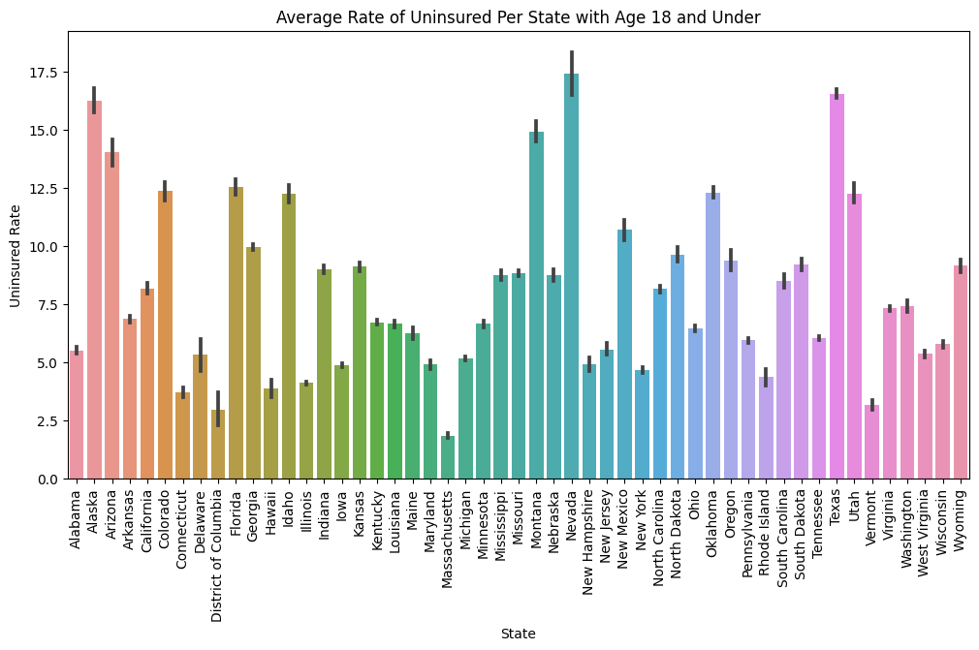
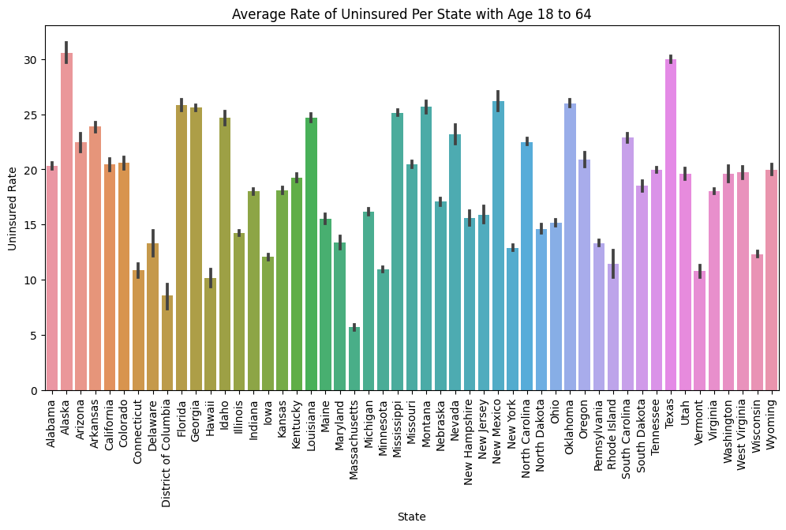
Exploratory Data Analysis
Insights:
Maximum Uninsured Rate 18under: State: Nevada, Value: 17.427279411764708
Minimum Uninsured Rate 18under: State: Massachusetts, Value: 1.8259821428571428
Maximum Uninsured Rate 18to64: State: Alaska, Value: 30.568874458874458
Minimum Uninsured Rate 18to64: State: Massachusetts, Value: 5.689821428571428

Slide 12
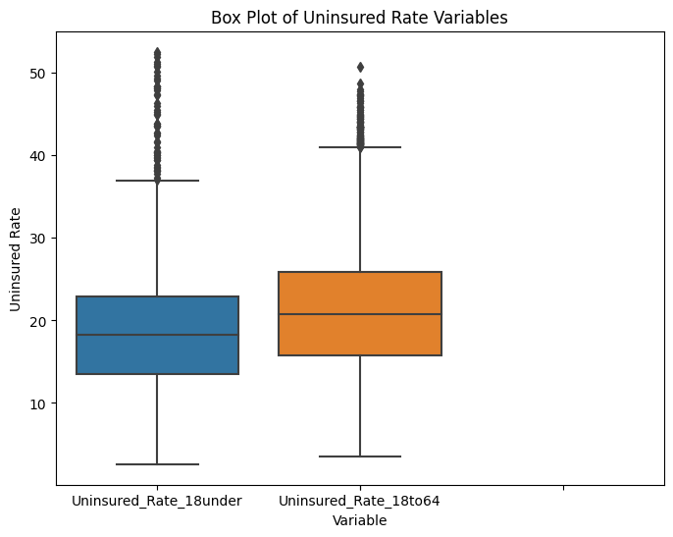
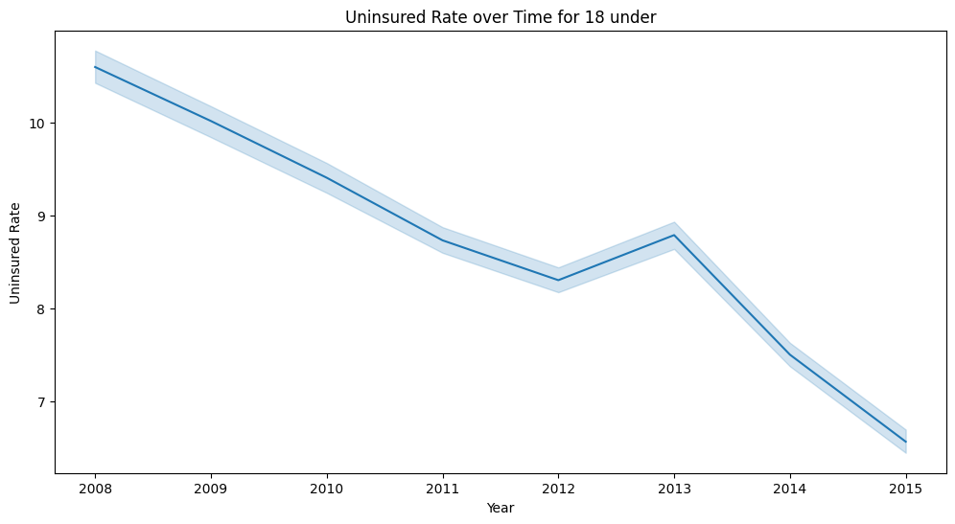
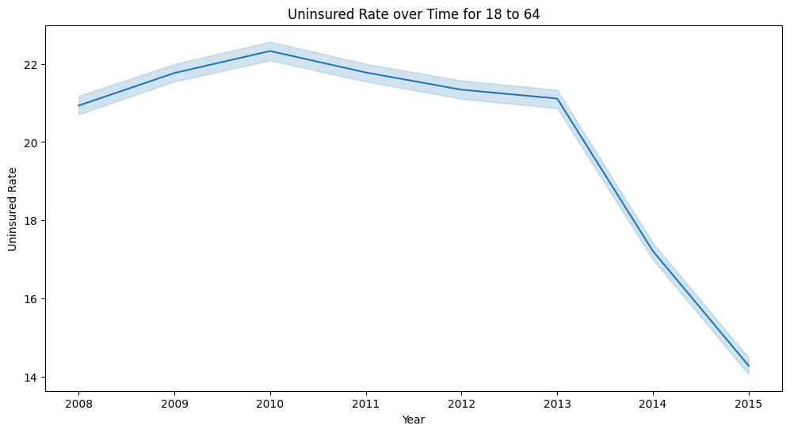
Insights:
The box plot reveals the existence of outlier values in the uninsured rate for individuals aged 18 and under, as well as those aged 18 to 64.

Slide 13
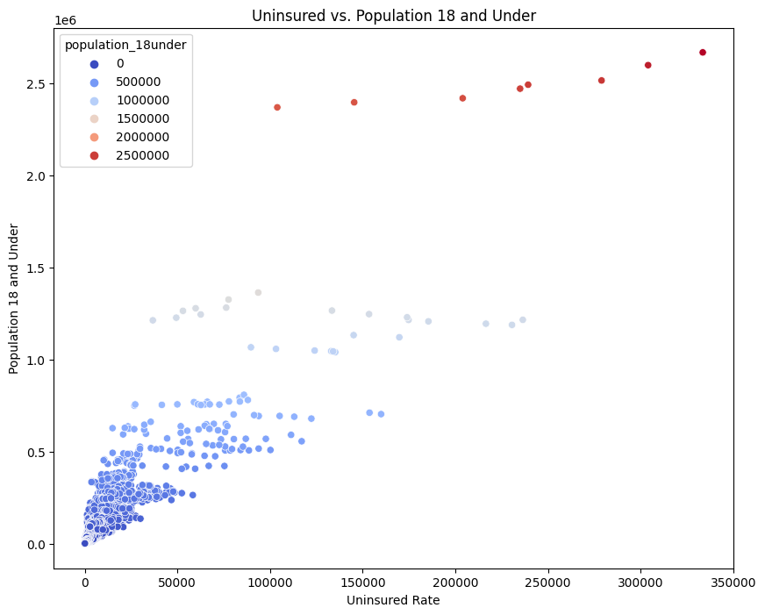
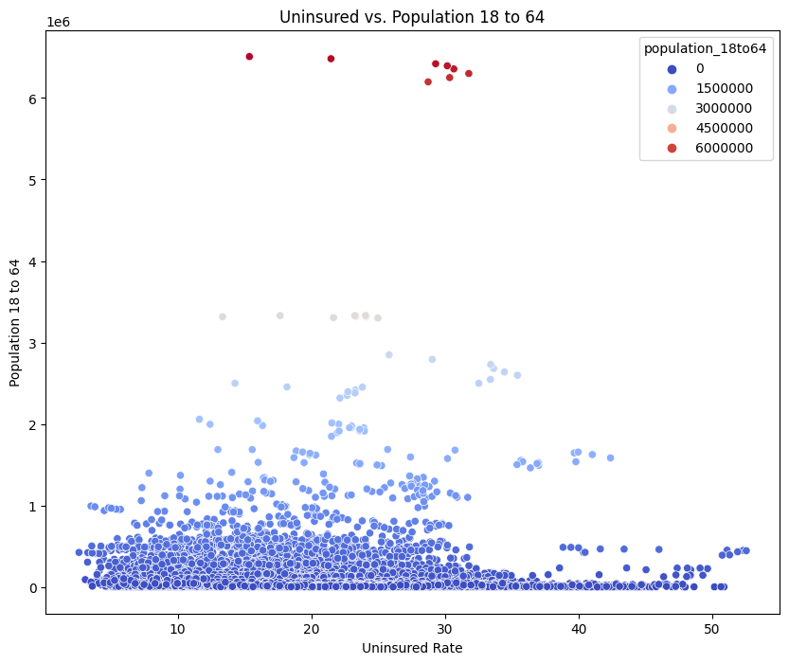
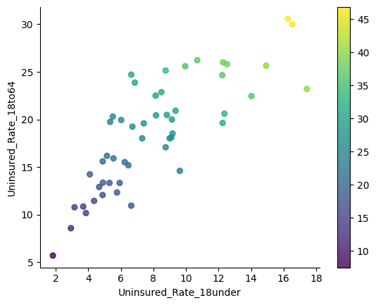
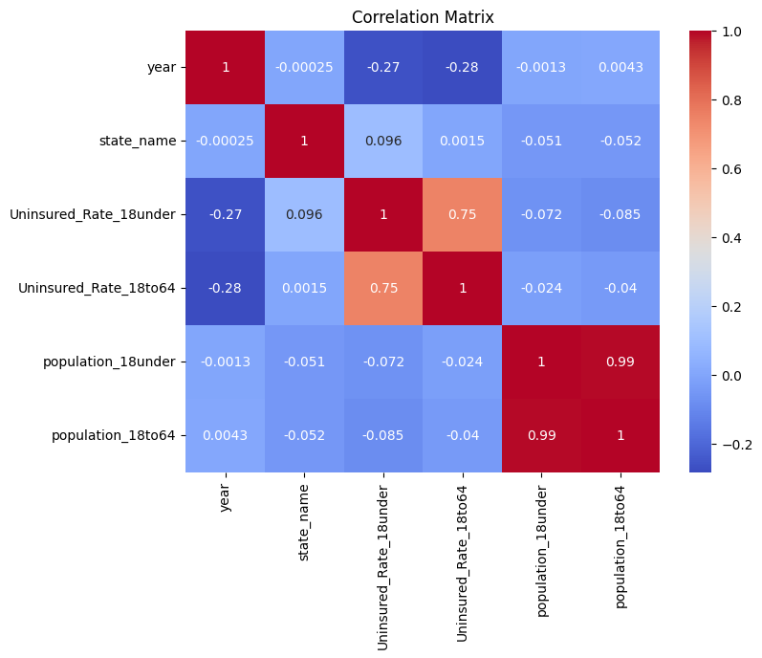
Insights:
Uninsured vs. Population 18 and Under has no correlation
Uninsured vs. Population 18 to 64 has no correlation
Uninsured_Rate_18under vs Uninsured_Rate_18to64 has low positive correlation

Slide 14
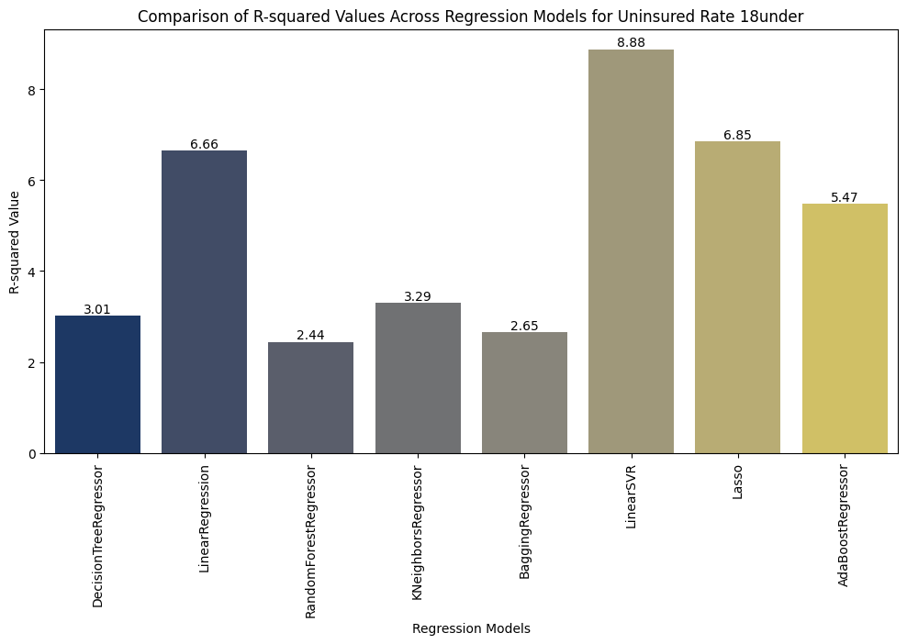
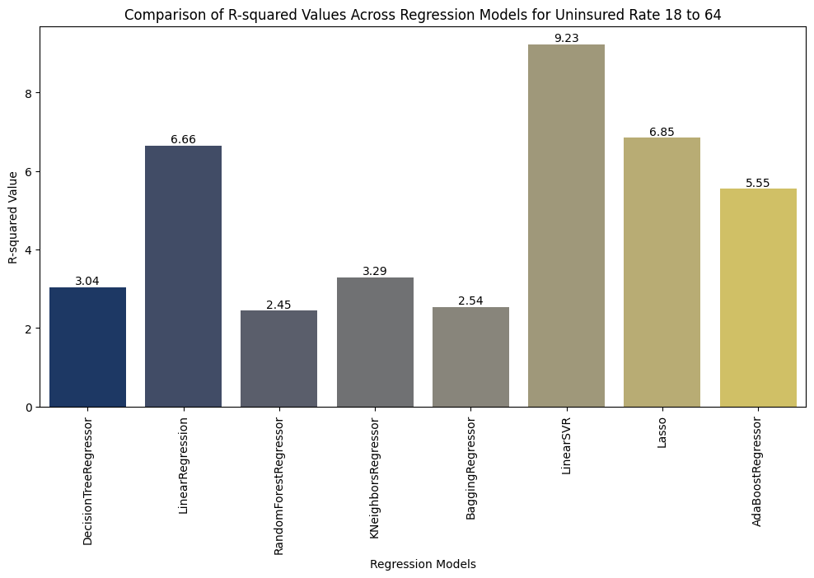
Feature Engineering
Dropping the 'state_fips', 'county_fips', and 'state_abbr' columns during feature engineering where these columns do not provide meaningful or useful information for the specific analysis or machine learning task at hand.
Separate the dataset into input features (X) and the target variable (y).
Split the data into training and testing subsets using functions like train_test_split() from scikit-learn.
Model Development
Model development is done using regression algorithms such as Decision Tree Regressor, Linear Regression, Random Forest Regressor, K-Neighbors, Bagging Regressor, Linear SVR, Lasso, and AdaBoost Regressor.
Model Evaluation

Slide 15
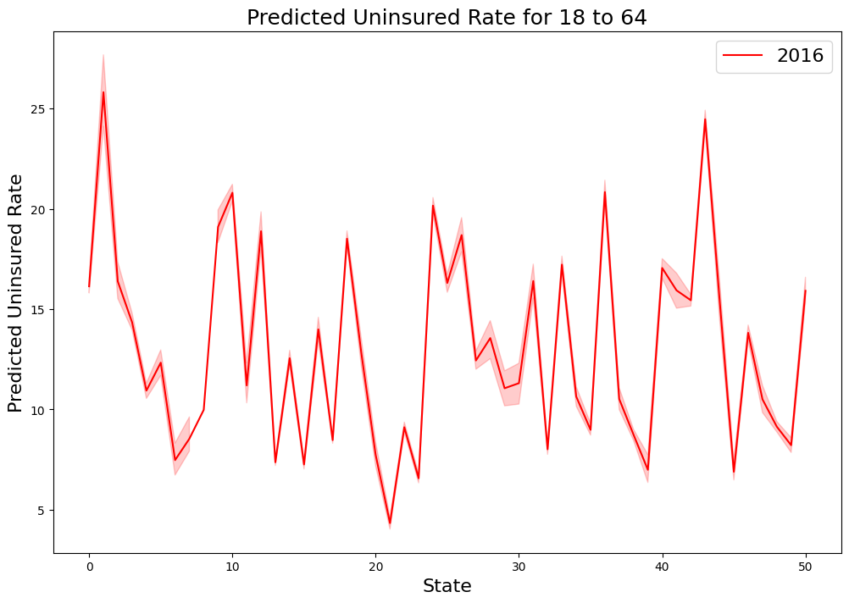
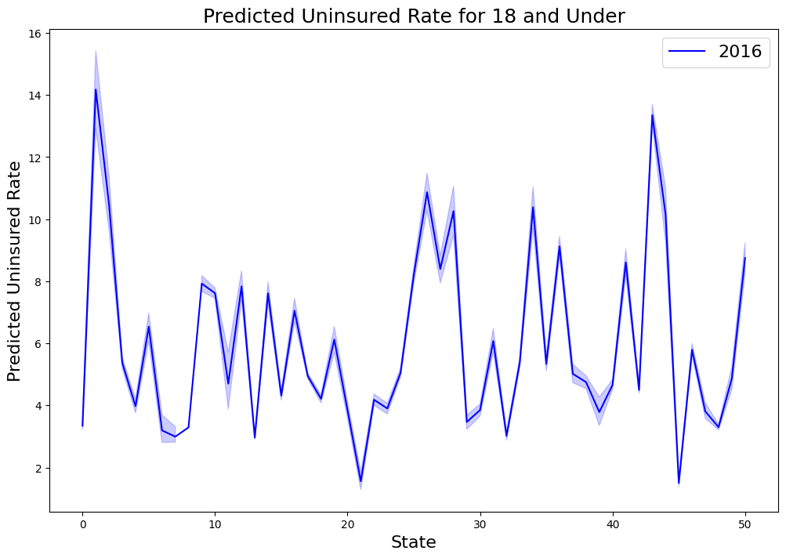
Predictions
Random Forest has shown promising performance in terms of RMSE value, indicating that it has been successful in capturing the underlying patterns and relationships in the data.
Random Forest is relatively robust to outliers and noise in the data.
Forecasting the future year results for 18 and Under also 18 to 64

Slide 16
Insights and Recommendations
Historical analysis of the uninsured rate data provides valuable context for interpreting the model predictions and understanding long-term trends.
The performance evaluation of the predictive model helps assess its reliability and accuracy in predicting the uninsured rate.
Future projections indicate potential changes and trends in the uninsured rate, which can be influenced by factors such as policy changes and economic conditions.
The predicted uninsured rates have important policy implications and can inform decision-making regarding policy interventions and reforms.
Targeted interventions based on the predicted uninsured rates can help address specific populations or regions that are at higher risk of being uninsured.
Collaboration and engagement with stakeholders enhance the development of effective strategies and initiatives to address uninsured rate challenges.

Slide 17

Any Questions ??

Slide 18

Thank you !!

